Slide 1
Closed Loop Cycle Production in Trinidad & Tobago
Presenter:
Dr Rikhi Permanand
Executive Director
Economic Development Board (EDB)/
Council for Competitiveness and Innovation (CCI)
1 December 2014

Slide 2
About the EDB and CCI
Economic Development Board (EDB) and
Council for Competitiveness and Innovation (CCI)
Both Government funded, public private sector operated advisory bodies to the Minister of Planning and Sustainable Development
Established in 2011
Operating since 2012
EDB Core Mandate:
Oversee the diversification strategy (7 industry clusters)
Develop the 5 economic growth poles
CCI Core Mandate:
Improve national competitiveness
Build national capacity for innovation
Supporting development of NIP & NIS

Slide 3
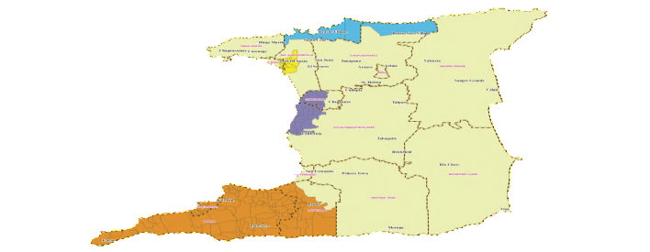
EDB: Diversification Clusters and Growth Poles
7 Industrial Clusters
5 Growth Poles
Food
North Coast Trinidad (Sustainable Development)
Energy
East Port of Spain
(Urban Regeneration)
Creativity
Maritime
Central
(Industrialisation)
Tourism
Southwest Peninsula
(Industrialisation)
Financial Services
ICT
North East Tobago
(Sustainable Development)

Slide 4
Clusters for Diversification
Food
Renewable Energy
Downstream petro-chemicals
Creativity
Music
Film making
Energy services
Maritime
Carnival/ Cultural events
Fashion
Tourism
Trans – shipment
Leisure marine
Eco
Sport
Medical
Ship repair
Maritime Services
Culture & heritage
Agricultural production
Fishing & Fish farming
Food processing
Printing & Packaging
Energy
Financial Services
Middle & back office support
ICT
Software Development
ICT services
Capital Market Development
Data Centers
Import Sub.
Exports
Enablers
ICT
Education & Training
Research & Development
Financial Services
Infrastructure
Intellectual Property

Slide 5
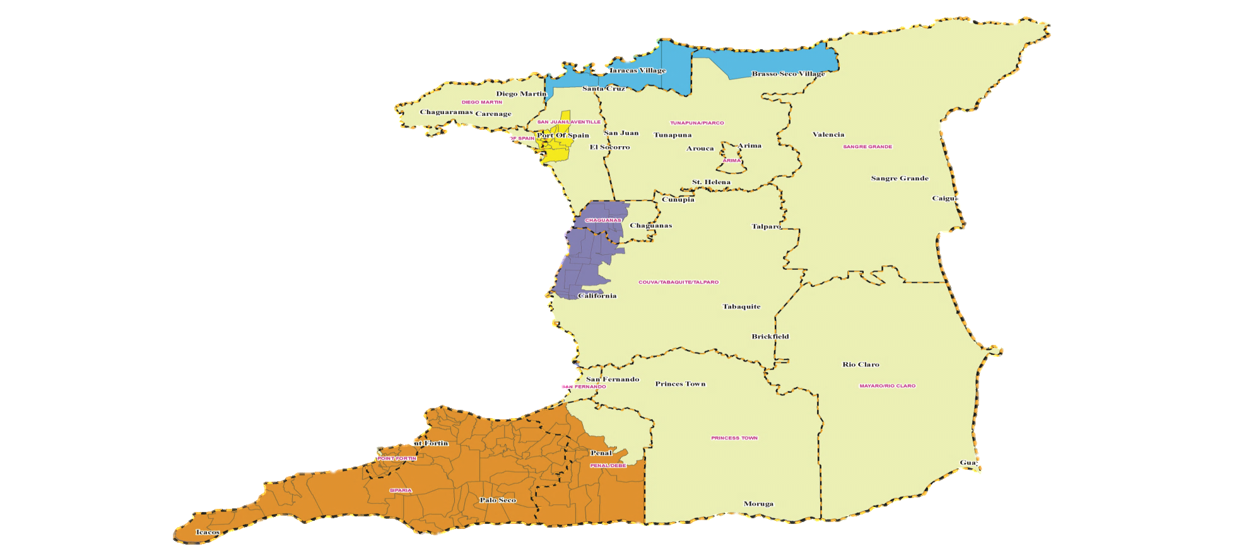
Growth Poles
North Coast Trinidad
Sustainable Development
North East Tobago
Sustainable Development
East Port of Spain
Urban Regeneration
“Four Cs”
Industrialisation
South West Peninsula
Industrialisation

Slide 6
CLCP and the EDB/CCI
Due to the direct and positive relationship between food sustainability and the CLCP Project in Trinidad, Cabinet Minute No. 2797 of October 9, 2014, appoints the Executive Director of the Economic Development Board to the role of the national authority for Trinidad and Tobago
The Executive Director of the EDB is therefore responsible for endorsing, authorizing and guiding the implementation of activities related to the CLCP project.

Slide 7
CLCP and the EDB/CCI
August 2013
Ministry of Planning receives invitation to participate
February 2014
Printing and Packaging selected as target industry
March 2014
1st OAS Mission:
OAS contributes grant - US$1million to the project
Aim: to reduce/eliminate Styrofoam
Stakeholder Meeting
Production Sector Diagnosis

Slide 8
CLCP and the EDB/CCI
April 2014
CLCP Workplan Developed
September 2014
2nd OAS Mission
October 2014
Cabinet appoints a National Champion
Data collection
Letter of Intent signed
Tech Cooperation Agreement almost complete
Official Launch @ ACF

Slide 9
CLCP: Why the interest?
Innovative business development tool
Positive impact on the environment
Increased productivity
Increased competitiveness
Enhanced sustainability

Slide 11
CLCP – 2nd OAS Mission
EDB hosted CLCP mission from Sept 23 – 26th, 2014 to facilitate data collection by specialists attached to the OAS
Data collection focused on:
Size of Printing and Packaging Industry
Quantity of Styrofoam products manufactured, used and discarded
Possible feedstock options for alternative packaging product
Amount of land available for agricultural production
Quantity of feedstock required to replace Styrofoam

Slide 12
CLCP: Next Steps
Post ACF:
CLCP application related to Styrofoam already exist
Demonstrate potential to fast track manufacturing
Partner with existing CLCP manufacturers
Potential to engage local private sector engaged in manufacturing
3rd Mission – Dec 1 -5th, 2014: Further Data Collection
Potential feedstock options – functionality/availability
Technology for transforming feedstock
Market size/opportunity

Slide 13
CLCP: Next Steps
Assessing T&T’s current position & potential to manufacture
Market Test to gauge local consumer response
accompanied by communications / public education campaign
Session to expose interested parties to new business opportunity
Finalisation of Revised Workplan

Slide 14
Key Considerations: CLCP
Policy and legislative implications of this project need to be considered: Styrofoam?
This is likely to be done as part of a wider Green Policy review, where the implications of similar measures in other Caribbean countries can be taken into account.
Research pertaining to export opportunities arising from this project will also be conducted.

Slide 15
Key Considerations: CLCP
Research pertaining to post-use options is important.
Facilitating high value added technical skill and knowledge transfer to further service the needs of industry is a critical component of this project.

Slide 16
Key Considerations: CLCP
Partnering with academic/educational institutions will be key in order to facilitate knowledge transfer.
CLCP project also represents a real opportunity for academic institutions to develop centers of expertise in material science, engineering and chemistry.
Such centers can further service the needs of industry and help to propel Trinidad and Tobago in the direction of becoming an innovation based, knowledge driven leader in Latin America and the Caribbean.

Slide 17
UNLEASHING HUMAN IMAGINATION... Fostering Positive Change
Advancing the Diversification Agenda:
THANK YOU FOR YOUR TIME!

